Slide 1
Smart Green Mind
Demo demonstration

Slide 2
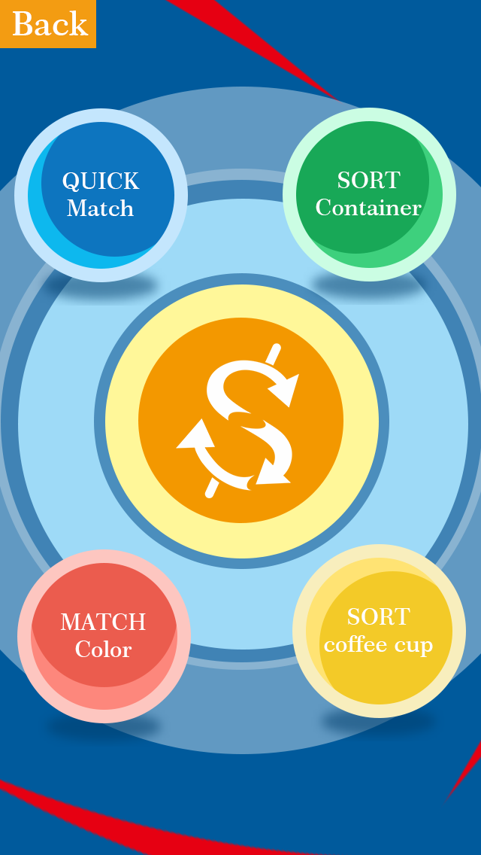
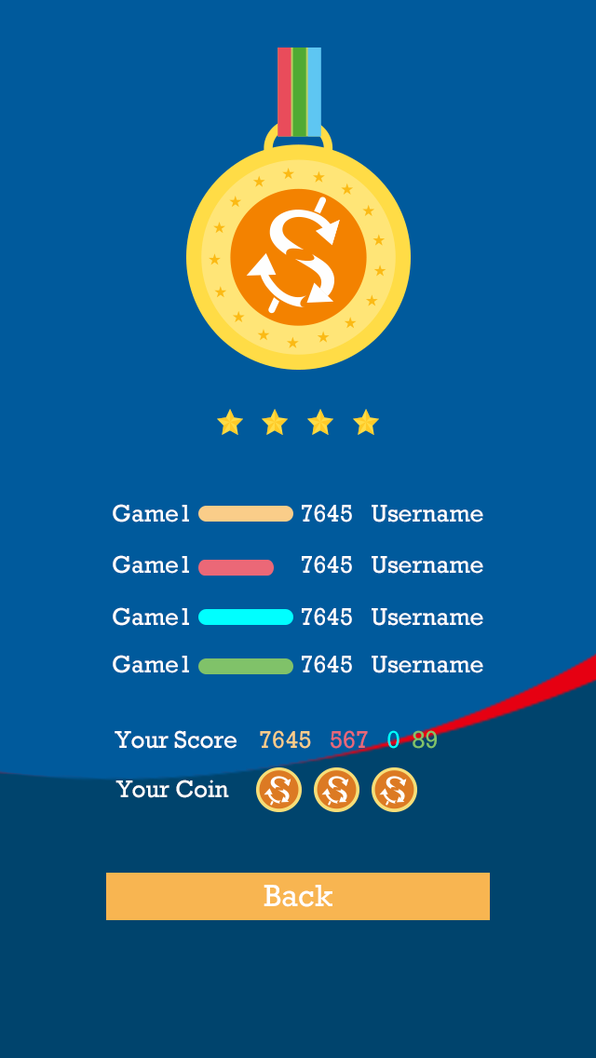
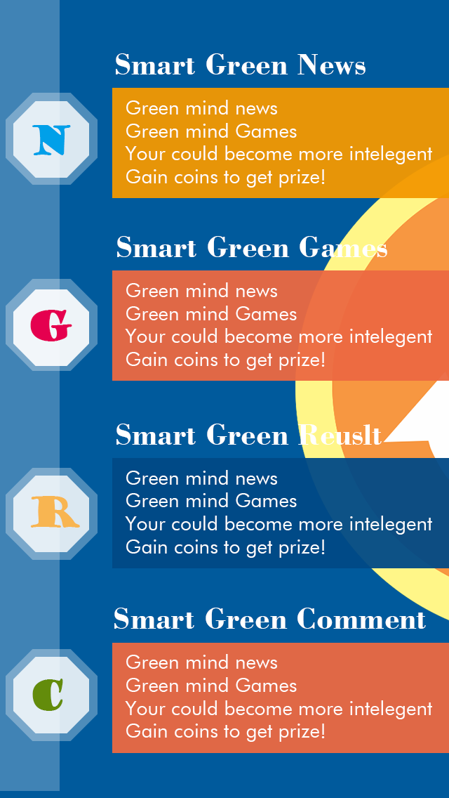
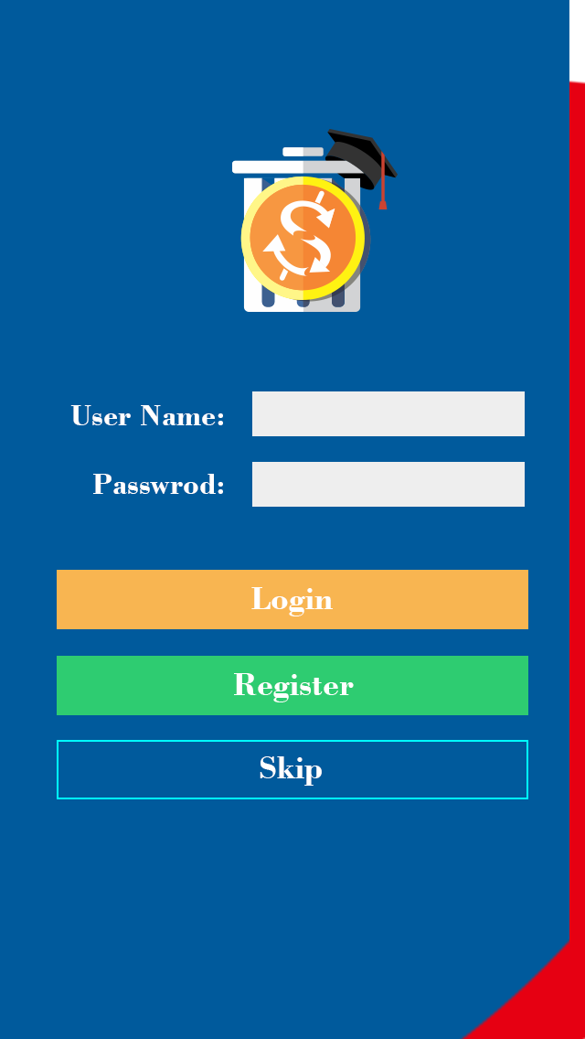

Game Menu Page
Result Page
Main Page
Login Page
Loading Page
Notes:
1.The smart green news module will be used for waste recycling information displaying.
2.The smart green games module will be used for game displaying.
3.The smart green result module will be used for user’s score displaying. In the future, this module could also be used for energy exchange or gif rewarding.
4.The smart green comment is a temporary module which is used for collect player’s feedbacks for future improvement.

Slide 3
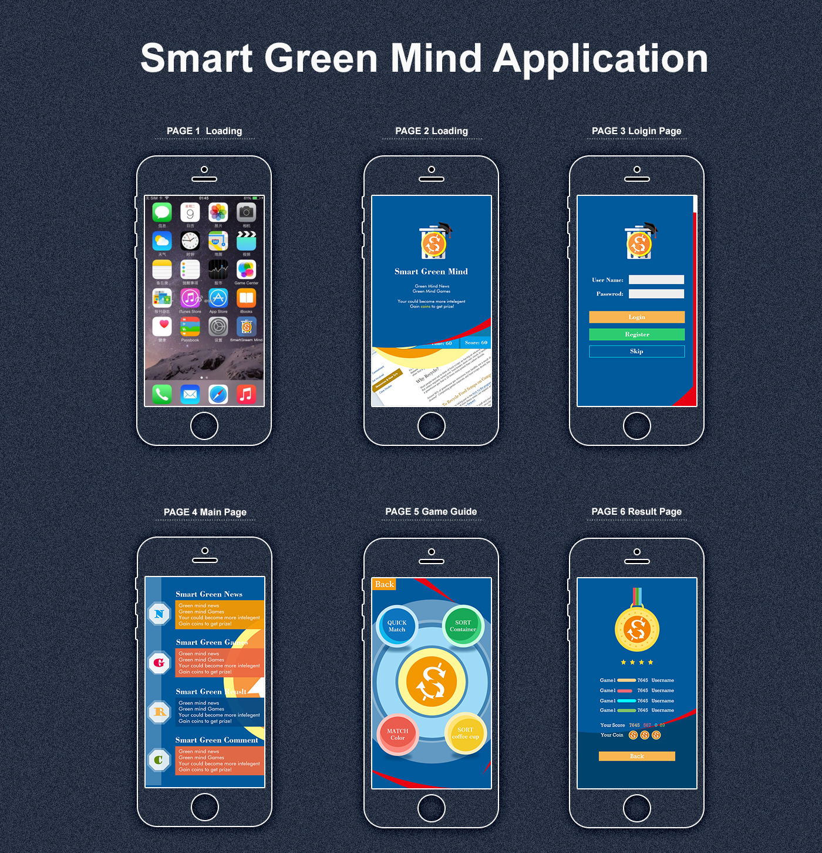
Visual Screen

Slide 4
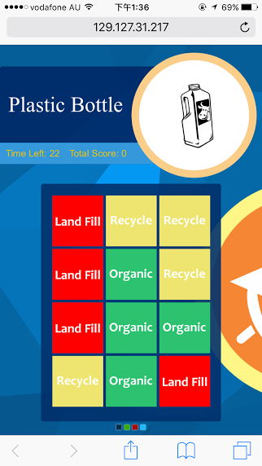
Game1 Match colour(general game) Game2 Quick Sort (general game) Game3 Sort coffee cup(specific game) Game4 container sort(specific game)
Notes:
1.The waste will be displayed randomly.
2. User need to click all right colour blocks according to waste type.

Slide 5

Game1 Match colour(general game) Game2 Quick Sort (general game) Game3 Sort coffee cup(specific game) Game4 container sort(specific game)
Notes:
1.There will be a sequence of waste in the bottom.
2.The player need to drag each waste into correct waste bin.

Slide 6
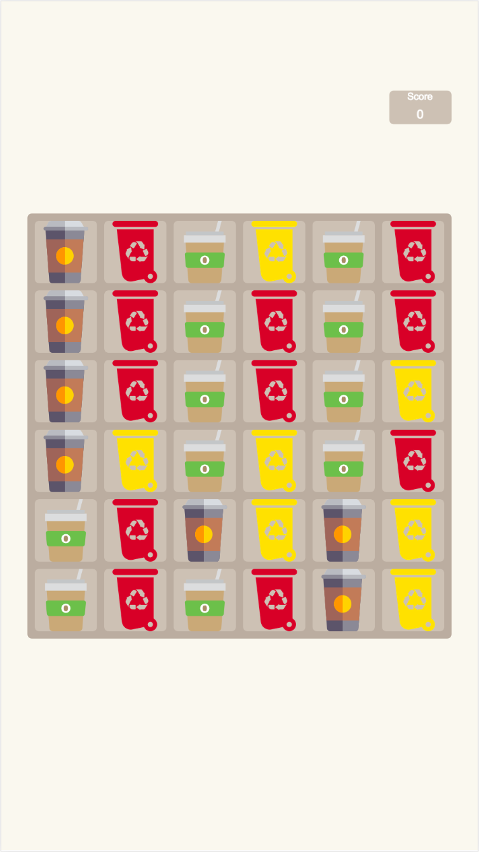
Game1 Match colour(general game) Game2 Quick Sort (general game) Game3 Sort coffee cup(specific game) Game4 container sort(specific game)
Notes:
The waste icons and waste bins wile be displayed randomly.
The user click a waste icon(or bin) first.
Then user need to click a bin(or waste).
The bin(waste) must match the type of waste.

Slide 7
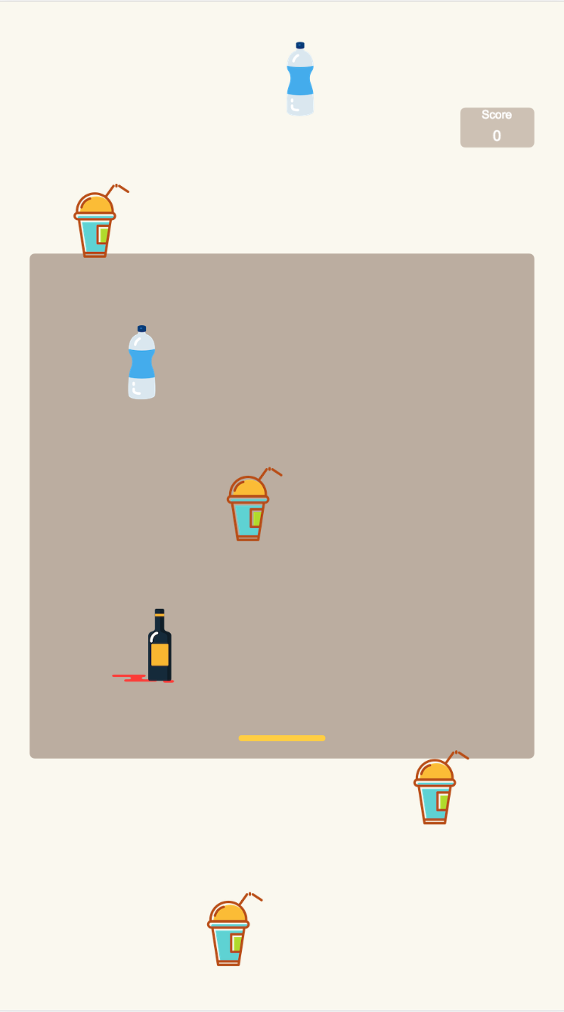
Game1 Match colour(general game) Game2 Quick Sort (general game) Game3 Sort coffee cup(specific game) Game4 container sort(specific game)
Notes:
There will be a “rain” of waste falling down from the top.
User needs to move a bar to catch the waste.
The colour of the bar will change randomly .
When a waste is caught, the colour of the bar must be right according to the waste’s type.

